Slide 1

Breast Cancer Detection Using AdaBoost Classifier
Presented by: Team 2
Team Members :
Kiruthikaa T
Durgam Adithi
Karen Nivedha P
Katteboina Charitha
S Madhu

Slide 2

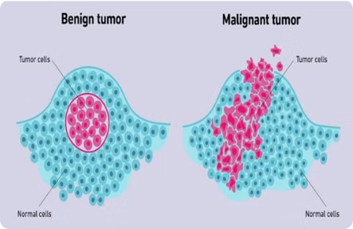
Understanding Breast Cancer
What is Breast Cancer?
Breast cancer is a disease where malignant tumors develop within breast tissue. Early detection is essential, as it increases the effectiveness of treatment and survival rates.
Types of Breast Cancer
Malignant (cancerous, capable of spreading) vs. Benign (non-cancerous). Differentiating between these types is crucial for appropriate treatment decisions.

Slide 3
Importance of Early Detection and Role of Machine Learning
1
Why Early Detection is Crucial
Early detection significantly improves treatment success and patient outcomes.
2
Machine Learning in Medical Diagnosis
Machine learning helps analyze vast datasets, identifying patterns for early diagnosis, and distinguishing benign from malignant cases.
3
Algorithms Used
AdaBoost and similar models are particularly useful for classifying data, as they recognize subtle, predictive patterns within features.

Slide 4
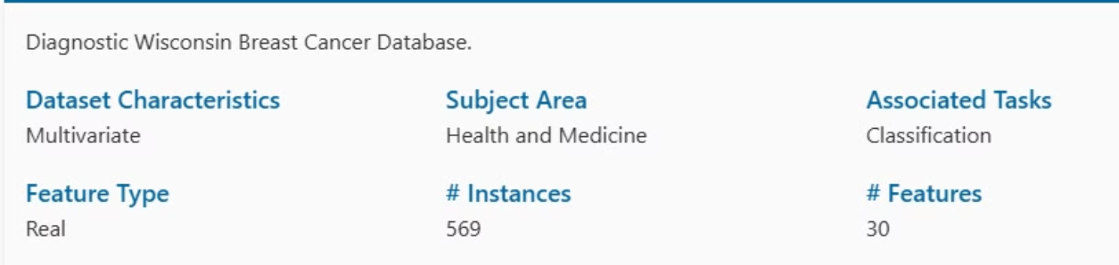
Problem Statement
Problem: Accurate classification of breast cancer as malignant or benign.
Dataset: UCI Breast Cancer Wisconsin dataset, which provides relevant features for diagnosis.

Slide 5

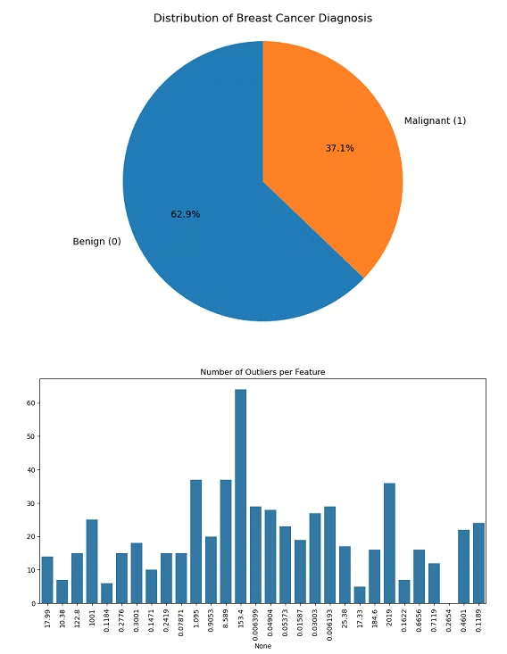
Data Preprocessing Steps
1
Handling Missing Values
No missing values were found, indicating data readiness.
2
Feature Scaling
Standard scaling was applied to normalize feature magnitudes, ensuring no feature dominates the model's predictions.
3
Label Encoding
Encoded the diagnosis column, where malignant cases are mapped as 1 and benign as 0.
4
Outlier Detection
To improve the model’s robustness, ensuring data quality before moving into training.

Slide 6
Dataset Shape and Statistical Summary
Dataset Shape
568 rows and 31 columns
Duplicates
0% duplicate rows found.
Encoded Diagnosis
Malignant (M) = 1, Benign (B) = 0
Malignant cases
212
Benign cases
357
The balanced distribution ensures the model can classify both types effectively.

Slide 7
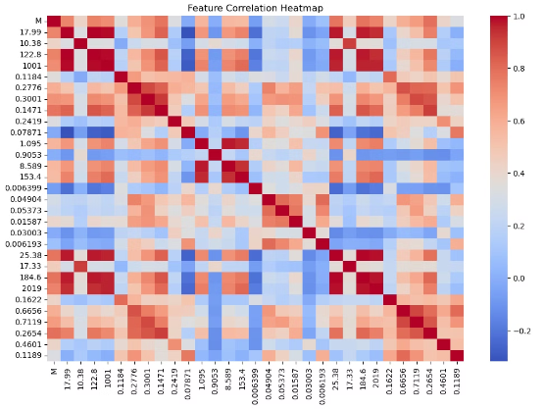
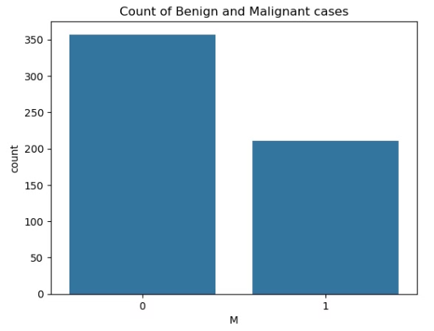
Data Visualization and Feature Insights
Correlation Heatmap
Class Distribution Plot
The heatmap shows strong relationships between features like cell radius, area, and perimeter.
Visualizes the balance between benign and malignant cases.
A balanced dataset (357 benign, 212 malignant cases) reduces bias, enabling the AdaBoost model to learn both classifications equally.
High correlations among features help the model identify patterns specific to malignant and benign cases, supporting its diagnostic accuracy.

Slide 8
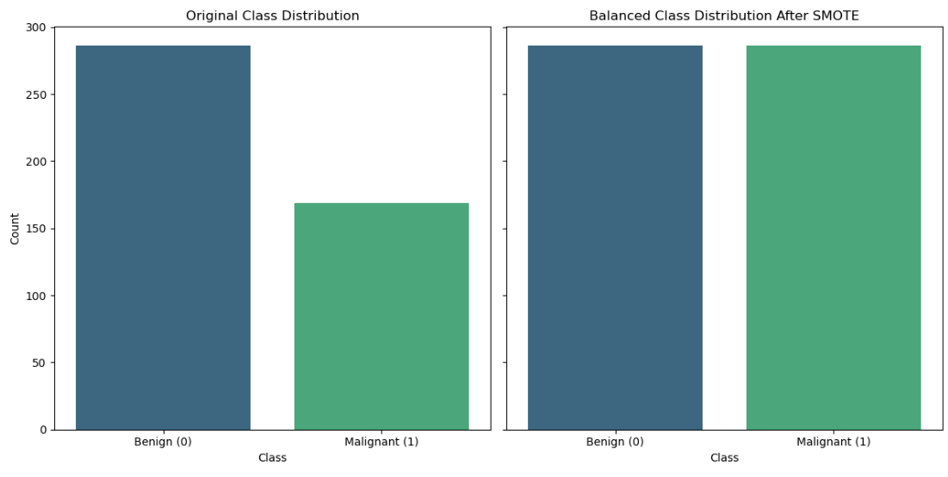
Class distribution before and after SMOTE

Slide 9
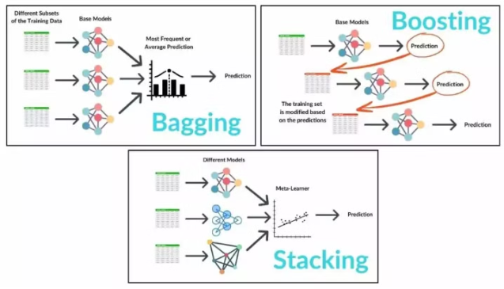
Ensemble Techniques & Their Types
A method that combines multiple models (classifiers) to improve overall performance, making the prediction more accurate and robust than individual models.
1
Bagging (Bootstrap Aggregating):
Example: Random Forest.
Types of Ensemble Techniques:
Trains multiple models on random subsets of data and combines their predictions by averaging (regression) or voting (classification).
2
Boosting:
Example: AdaBoost, Gradient Boosting.
Focuses on combining weak learners, with each new model correcting errors made by previous models.
3
Stacking:
Combines multiple models (often from different algorithms) by training a meta-model to predict the final output based on their predictions.

Slide 10

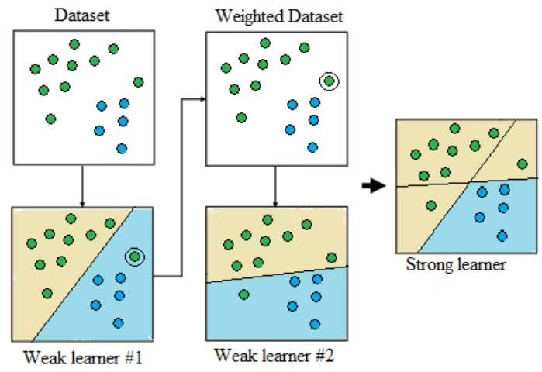
AdaBoost Algorithm: Basic Principles
AdaBoost Overview:
Ensemble Method: Combines multiple weak classifiers to create a strong model.
Weak Classifier: A model slightly better than random guessing (e.g., decision stumps).
How AdaBoost Works:
1
1. Initial Weights
Start by giving equal weight to all instances in the training set.
2
2. Weak Learners
Build weak learners (simple models like decision stumps).
3
3. Focus on Mistakes
Misclassified instances get higher weights, forcing the next model to focus on them.
4
4. Combine Classifiers
After several rounds, combine the weak learners with weighted voting to make the final prediction.

Slide 11
Evaluation Metrics Outputs
Metric
Without Outliers
With Outliers
Accuracy
0.9625
0.9825
Precision
0.9583
0.9767
Recall
0.9200
0.9767
F1 Score
0.9388
0.9767
Without Outliers
With Outliers
Precision: 95.83% of the predictions for malignant cases are correct.
Precision: 97.67% of the predictions for malignant cases are correct.
Recall: 92.00% of the actual malignant cases are identified.
Recall: 97.67% of the actual malignant cases are identified.

Slide 12
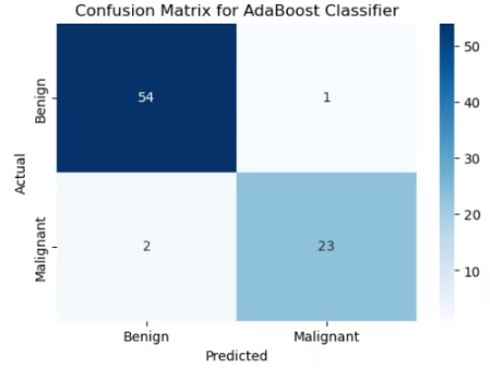
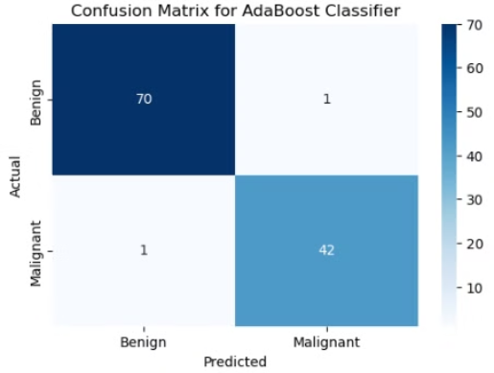
Confusion Matrix Results
Without Outliers
With Outliers
True Positives (TP): 23 (Malignant correctly identified)
True Positives (TP): 42 (Malignant correctly identified)
True Negatives (TN): 54 (Benign correctly identified)
True Negatives (TN): 70 (Benign correctly identified)
False Positives (FP): 1 (Benign incorrectly identified as Malignant)
False Positives (FP): 1 (Benign incorrectly identified as Malignant)
False Negatives (FN): 2 (Malignant incorrectly identified as Benign)
False Negatives (FN): 1 (Malignant incorrectly identified as Benign)

Slide 13

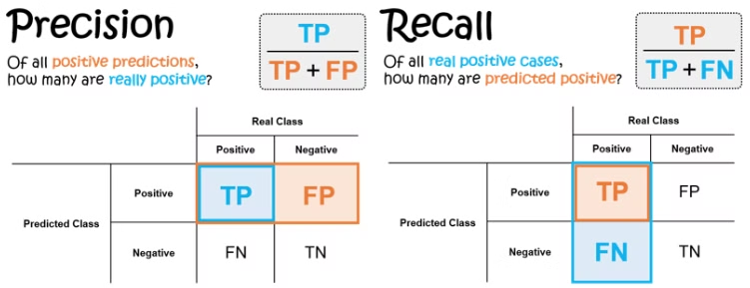
Interpretation of Performance Metrics in Medical Diagnosis
Precision: Prevents unnecessary treatments (e.g., biopsies, chemotherapy).
Recall: Ensures all potential positive cases are identified, especially in critical diseases like cancer.
Trade-off:
There is often a trade-off between precision and recall. In medical diagnosis, recall is typically prioritized to ensure critical conditions are not missed, even at the cost of potentially increasing false positives.

Slide 14

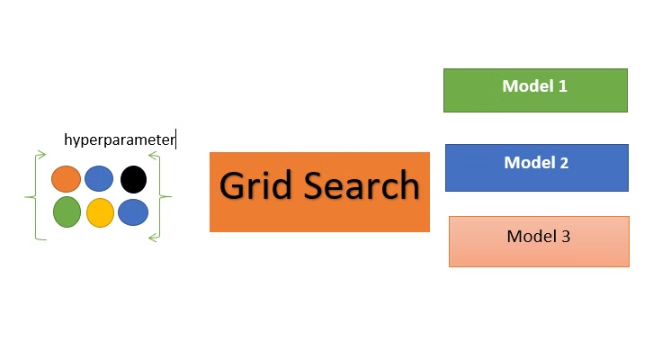
Hyperparameter Tuning with GridSearchCV
Optimize the hyperparameters of the AdaBoost classifier using GridSearchCV.
Parameters Tuned:
n_estimators: Number of weak learners in AdaBoost.
learning_rate: Controls the weight of each weak learner.
estimator__max_depth: Depth of the decision trees used in AdaBoost.

Slide 15
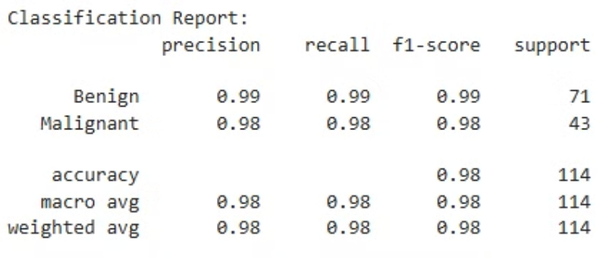
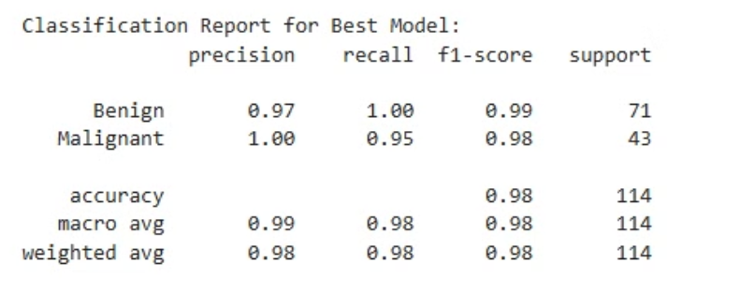
Model Evaluation (Tuned AdaBoost Classifier)
After Hyperparameter Tuning:
Before Hyperparameter Tuning:
Accuracy: 98.25% (unchanged)
Accuracy: 98.25%
Precision: Improved to 100%
Precision: 97.67%
Recall: Slightly reduced to 95.35%
Recall: 97.67%
F1 Score: 97.62% (marginal decrease)
F1 Score: 97.67%

Slide 16

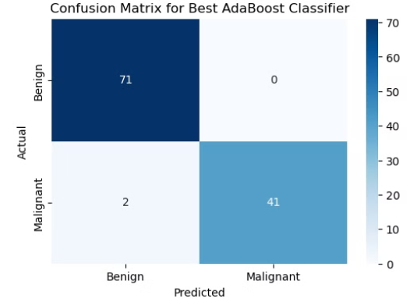
Interpretation of Confusion Matrix Results
Before Hyperparameter Tuning
After Hyperparameter Tuning
True Positives (TP): 42 (Malignant correctly identified)
True Positives (TP): 41 (Malignant correctly identified)
True Negatives (TN): 70 (Benign correctly identified)
True Negatives (TN): 70 (Benign correctly identified)
False Positives (FP): 1 (Benign incorrectly identified as Malignant)
False Positives (FP): 0 (Benign incorrectly identified as Malignant)
False Negatives (FN): 1 (Malignant incorrectly identified as Benign)
False Negatives (FN): 2 (Malignant incorrectly identified as Benign)

Slide 17

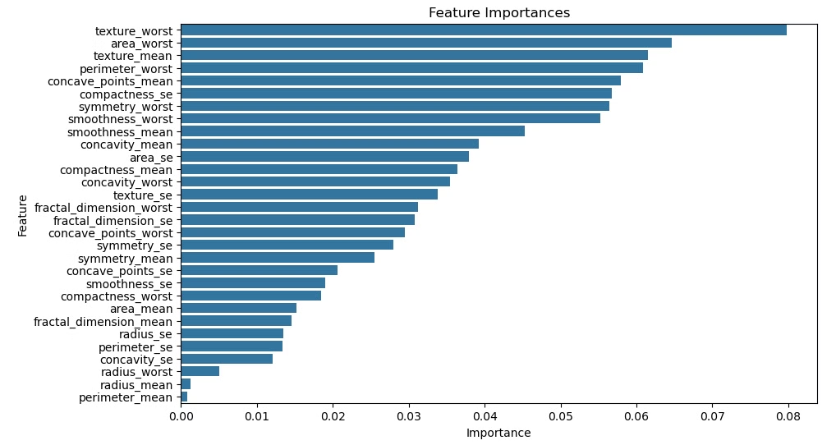
Feature Importances
Understand the most influential features that the AdaBoost classifier used to make predictions.
Top Features:
Texture_worst: Most influential with an importance of 0.0798.
Area_worst: A close second with 0.0647 importance.
Texture_mean and Perimeter_worst are also significant, contributing around 0.0615 and 0.0608, respectively.
Least Important Features:
Radius_mean: Has the lowest importance value of 0.0012.
Perimeter_mean: Also very low at 0.0008.

Slide 18
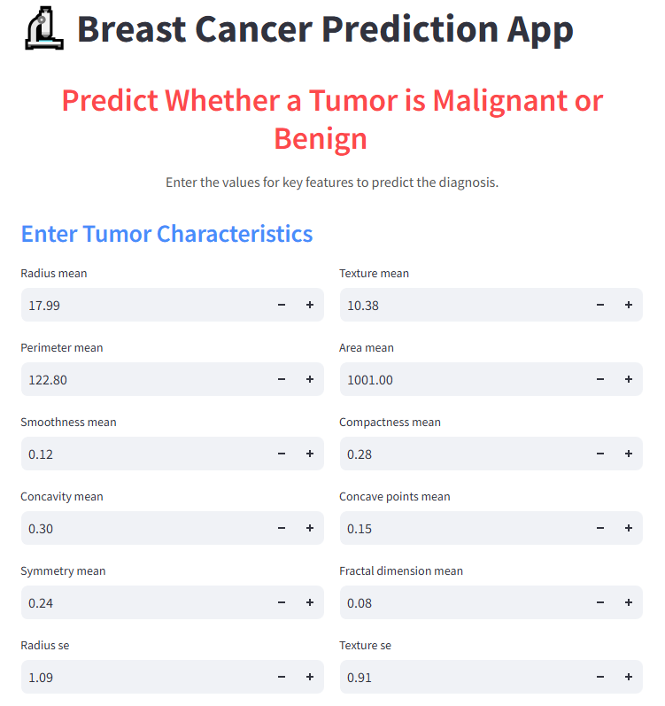
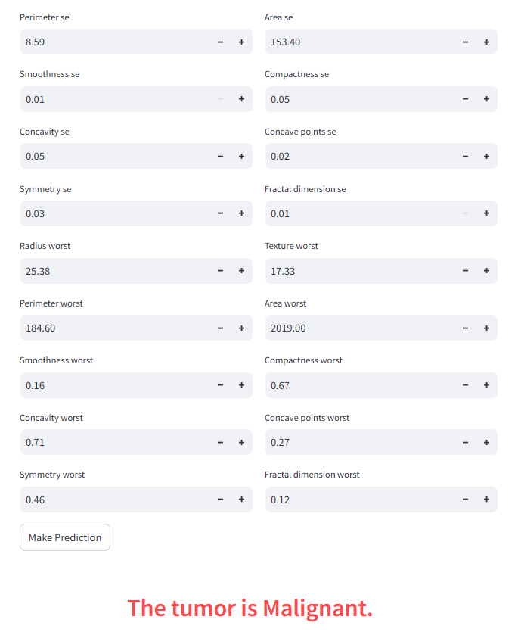
Streamlit App

Slide 19

Thank You

